Slide 1



Branch
Submitted by : Ayush Rai ,
Pavneet Kaur , Ranu Rajput & Rashmi Garg .

Slide 2


Agenda
Introduction
What is Git Branch
How it works
Operations on Branches

Slide 3

Introduction
A branch is a version of the repository that diverges from the main working project.
It is a feature available in most modern version control systems.
A Git project can have more than one branch.
These branches are a pointer to a snapshot of your changes.
In Git, branches are a part of your everyday development process. Git branches are effectively a pointer to a snapshot of your changes.
When we want to add a new feature or fix a bug, we spawn a new branch to summarize our changes.

Slide 4
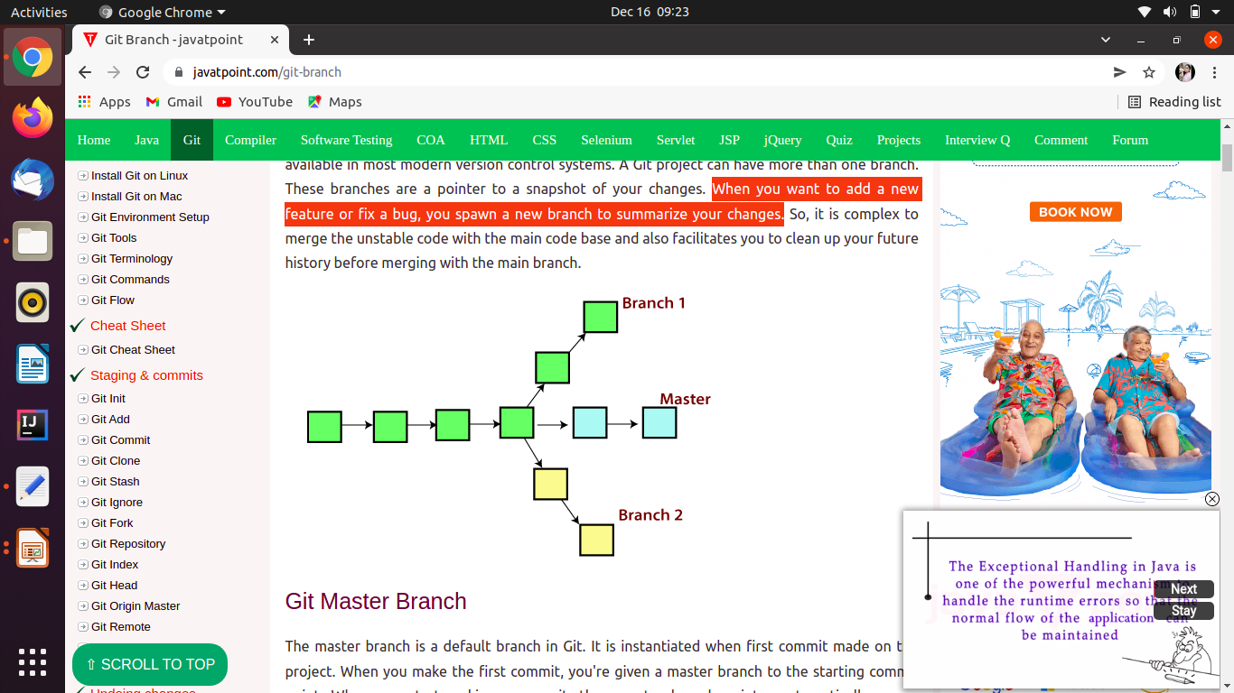

Slide 5
How Git Branch Works
A branch represents an independent line of development. Branches serve as an abstraction for the edit/stage/commit process.
New commits are recorded in the history for the current branch, which results in a fork in the history of the project.
The git branch command lets you create, list, rename, and delete branches. It doesn’t let you switch between branches or put a forked history back together again.
git branch is tightly integrated with the git checkout and git merge commands.

Slide 6
Git Master Branch
The master branch is a default branch in Git.
It is instantiated when first commit made on the project.
When we make the first commit, we're given a master branch to the starting commit point.
When we start making a commit, then master branch pointer automatically moves forward.
A repository can have only one master branch.
Master branch is the branch in which all the changes eventually get merged back.
It can be called as an official working version of your project.

Slide 7
Operations on Branches
Create Branch
List Branch
Delete Branch
Delete a Remote Branch
Switch Branch
Rename Branch
Merge Branch

Slide 8
Create Branch
We can create a new branch with the help of the git branch command.
Syntax:
$ git branch <branch name>
We can create a new branch with the help of the git branch command.
Syntax:
$ git branch <branch name>
We can create a new branch with the help of the git branch command.
Syntax:
$ git branch <branch name>
List Branch
Either we can use git branch - list or git branch command to list the available branches in the repository.
Syntax:
$ git branch --list
$ git branch

Slide 9
Delete Branch
In this command, Git prevents us from deleting the branch if it has unmerged changes.
Syntax:
$ git branch -d<branch name>
For specified branch
$ git branch -D <branch name>

Slide 10
Delete a Remote Branch
We can delete a remote branch from Git desktop application.
Syntax:
$ git push origin -delete <branch name>
Switch Branch
Git allows us to switch between the branches without making a commit. We can switch between two branches with the git checkout command.
Syntax:
$ git checkout<branch name>

Slide 11
Rename Branch
We can rename the branch with the help of the git branch command.
Syntax:
$ git branch -m <old branch name><new branch name>
Merge Branch
Git allows us to merge the other branch with the currently active branch. We can merge two branches with the help of git merge command.
Syntax:
$ git merge <branch name>

Slide 12
Thank You!

